Slide 1
Championing General Education: A Model for Faculty Engagement in the General Education Assessment Process
Stephany Dunstan, Ph.D.
Casie Fedukovich, Ph.D.
Justin Post, Ph.D.
Samantha Rich
Carrie Zelna, Ph.D.
Notes:
Presentation is from 11-12 on February 12.

Slide 2

Gen Ed Assessment at NC State
Competency-based Assessment
Critical thinking
Creative thinking
Oral communication
Quantitative literacy
Written communication

Slide 3
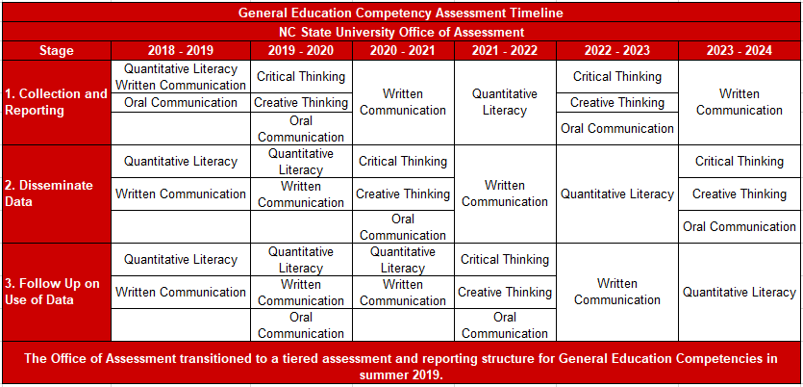
Gen Ed Assessment Cycle

Slide 4
How do we assess?
Standardized Assessments
Critical-thinking Assessment Test (CAT)
HEIghten Quantitative Literacy
HEIghten Critical Thinking
Authentic Assessments
Critical & Creative Thinking Rubric
Oral Communication Rubric
Written Communication Rubric

Slide 5
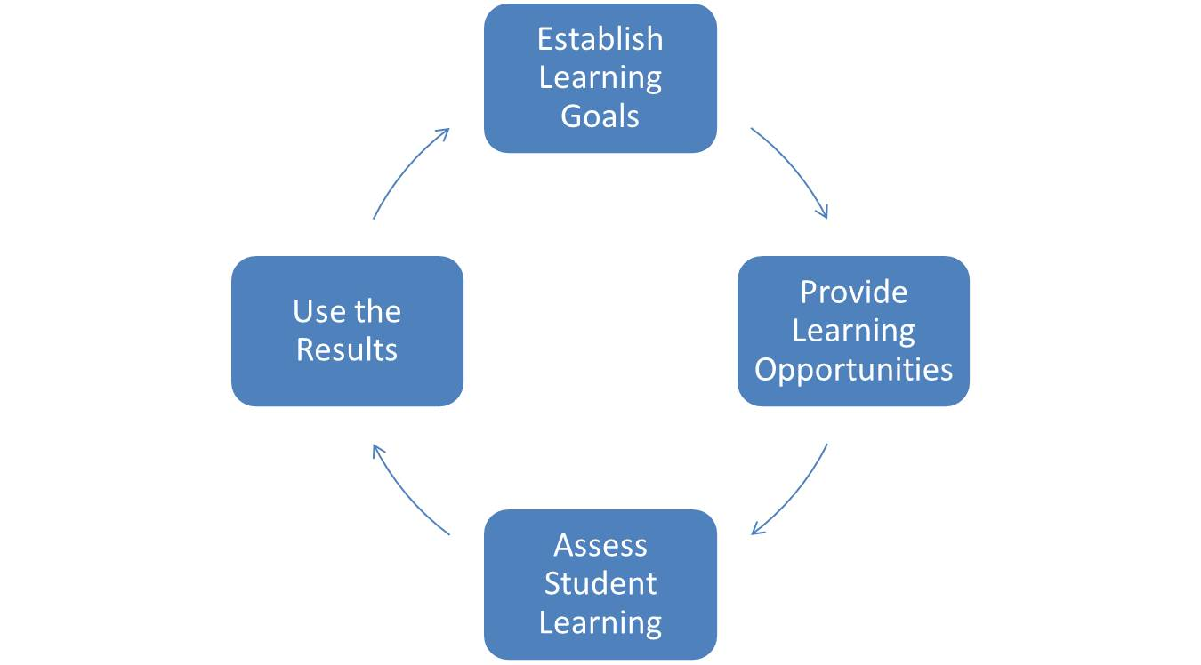
Challenges
Collecting representative samples
Faculty use of assessment data
Competency-based course interventions
Notes:
Image from: https://sites.psu.edu/ptfacultyfellowship/assessment-cycle/.

Slide 6

Gen Ed Competency Champions
Introduced in 2017
Competency-Specific
Expertise in area tied to competency
Interest in pedagogy
Leaders in faculty development
Interest in assessment and
data-informed decision making
Notes:
Identified by the Office of Assessment

Slide 7
Gen Ed Competency Champions
Quantitative Literacy
Dr. Justin Post (Dept. of Statistics)
Written Communication
Dr. Casie Fedukovich (Director of FYWP)
Oral Communication
Dr. Elizabeth Nelson (Dept. of Comm)
Critical & Creative Thinking
Dr. Sue Carson (Director of QEP)
Notes:
Background on each

Slide 8
Champion Roles
Consult with Assessment staff on Gen Ed Competency data collection
Lead campus presentations to stakeholders on findings
Engage with faculty to use assessment data
Meet with Assessment staff 2-3 times a semester
Consult with faculty on ad hoc basis
Roughly 2-3 presentations/curriculum meetings per semester
Work with faculty to report on how data are used to support student learning
Notes:
We can say that champions receive a stipend. The next slides demonstrate all the things we’ve been able to do with our champions.

Slide 9

Champions as Presenters
Faculty Senate presentation
Council on Undergraduate Education presentation
First Year Writing Program presentation
College level curriculum meetings
Departmental curriculum meetings

Slide 10

Champions as Sounding Board
Office of Assessment Website Redesign
Rebranding of General Education Competencies; consulting on Gen Ed Competency Campaign
“Pack Proficiencies”
Naming, posters, etc.
Visualizing and Presenting Data
PowerPoints
Website and print materials
Notes:
Pack Proficiencies poster handout

Slide 11
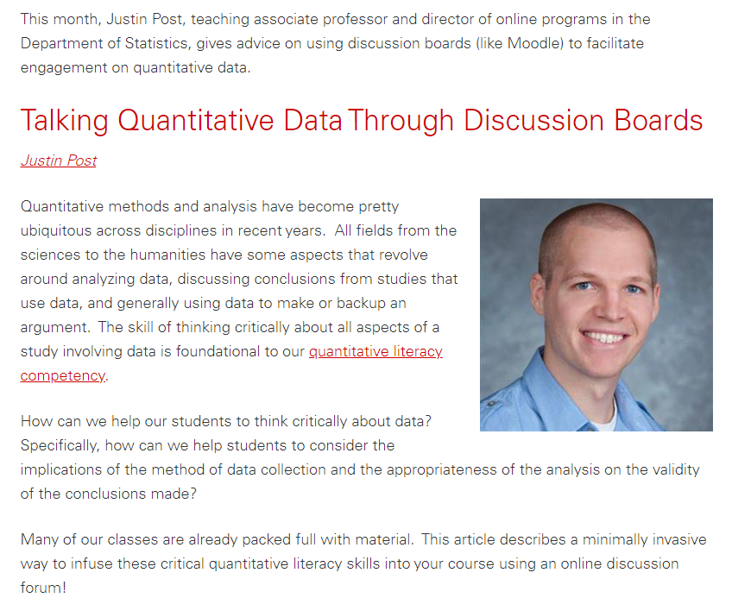
Champion Projects
Quantitative Literacy
Pack Hacks for Faculty
Distributed by Provost’s Office
Use of “worry questions” to promote analysis
Web resource
Guide to using CODAP to promote data exploration

Slide 12

Champion Projects
Quantitative Literacy
STEM Education Initiative Grant
Partnership with GN 311 faculty
Topic: Understanding proportions and Hardy-Weinberg equilibrium
Champion provides expertise in quantitative literacy pedagogy and data visualization
Notes:
Justin will likely want to clean these up! :) Could be more than 1 slide.

Slide 13

Champion Projects
Written Communication
Presentation
Office of Faculty Development: Teaching Revision
Web resources
Teaching Revision for website
Overview of First Year Writing Program
Pack Hack for Revision

Slide 14

Champion Projects
Critical and Creative Thinking
TH!NK Partnership
Promotional video
Faculty recruitment for assessments

Slide 15
Current/Future Projects
Onboarding Oral Communication Champion
Faculty workshop on using the common Oral Communication Rubric
Expanding the work of the STEM Education Initiative
Partnership with the Office of Faculty Development
Champion-led workshops slated for spring 2020
Lunch and learn with Department Heads
Data collection on closing the loop
How are other faculty using data to improve student learning?

Slide 16


Champion Experience
Notes:
I thought maybe here Justin could talk about what it’s like to be a champion. Maybe Casie could write something for us to read?
Justin’s thoughts on being a champion:
Really enjoyable to work with DASA and try to promote things that can directly have an impact on student success.
Presenting to groups on campus can be trying as they often get hung up on small things instead of focusing on the bigger picture and how what is being presented can help them in making decisions on what to improve/work on.
Working with faculty on individual courses the most rewarding. Great to talk about what they really want students to know and how we might be able to improve that.

Slide 17

Questions and Discussion

Slide 18
Citations
Nina Bailey and Alison McCulloch, “Developing Undergraduates’ Critical Statistical Literacy through the Use of Online Discussion Boards” (poster), 2019.
Gal, Iddo. (2002) Adults’ statistical literacy: Meanings, Components, Responsibilities. International statistical review. 70(1), 1-25.
Image: Assessment Cycle, available online from https://sites.psu.edu/ptfacultyfellowship/assessment-cycle/.

